Slide 1
Error Bars & Uncertainty in Slope
IB DP Physics

Slide 2
Error Bars
Used on graphs to display the uncertainty in measurements of the data points.
There may be uncertainty in just the y-values, just the x-values, or both.
Must be included in all DP Physics data analysis including your Internal Assessment

Slide 3
Displaying Error Bars in Excel
Create your scatterplot normally.
Select the data points.
Right click and choose “format data series”
Select “error bars” along the left menu.
Choose “x error bars” along the top first.

Slide 4
Choose “both” so that it displays error on either side of your data point.
If the uncertainty is a fixed amount (such as +/- 0.5 m), select “fixed amount” and enter the uncertainty.
If the uncertainty is a percentage (such as +/- 5%, select “percentage” and enter the percentage uncertainty.

Slide 5
In the case that the uncertainty is NOT the same for every one of your x-values, choose “custom” at the bottom, and then “specify value”
Manually enter, the error for each data point in succession, separated by commas where it says “positive error”.
Copy this into the box for “negative error”. (They are likely the same.

Slide 6
Repeat the process to display y error bars.
In some cases, the error in the x or y values may be so small that it does not really show, and therefore is not worth displaying. If this is the case, only display the uncertainty for one variable and make a note in your lab report why this is the case.

Slide 7
You should now have a graph that looks something like this….
- If your error bars are quite small relative to the size of your data points, you might consider adjusting the size of the markers.

Slide 8
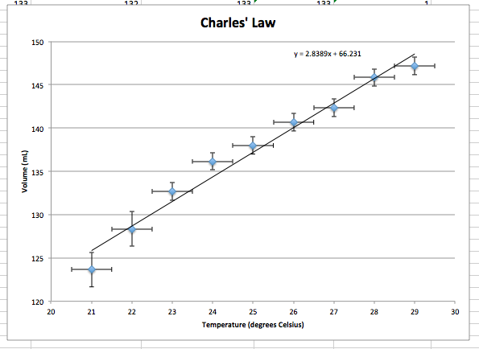
Line of Best Fit
Add a line of best fit as you normally do. This should be linear since you need to linearize your data.
Display the equation
on your graph

Slide 9
Uncertainty in slopes
Our line of best fit is a bit deceiving – we didn’t know the points EXACTLY, so we really can’t draw a line of best fit exactly (and make exact predictions with the equation).
Instead, we want to display the line of best fit also with uncertainty.

Slide 10
What does that mean?
We will actually display two more lines of best fit.
One will have the maximum possible slope based on the uncertainty of the data points.
The other will have the minimum possible slope.
We can conclude that the actual slope based on our data is somewhere between the two.

Slide 11
Creating the maximum slope
Think of the vertical and horizontal error bars as rectangles.
The maximum slope for line of best fit is drawn from the BOTTOM RIGHT corner of the first data point to the UPPER LEFT corner of the last data point (see diagram)
To display this line on Excel, we need to know the coordinates of these two corners, and then ask Excel to connect them.

Slide 12
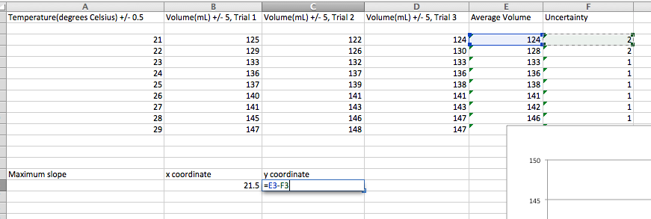
Creating the maximum slope
BOTTOM RIGHT CORNER OF THE FIRST RECTANGLE: the x coordinate is larger than the data point by an amount equal to the horizontal uncertainty.
The y coordinate is smaller than the data point by an amount equal to the vertical uncertainty.
Use Excel to calculate the coordinates for you.

Slide 13
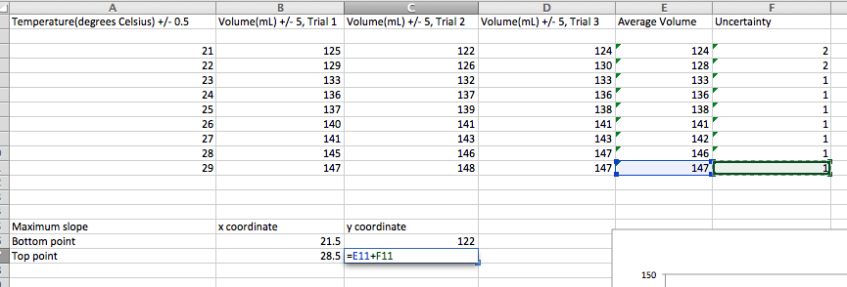
Creating the maximum slope
TOP LEFT CORNER OF THE LAST RECTANGLE: the x coordinate is smaller than the data point by an amount equal to the horizontal uncertainty.
The y coordinate is larger than the data point by an amount equal to the vertical uncertainty.
Use Excel to calculate the coordinates for you.

Slide 14
Creating the maximum slope
Add these data points to your graph as a separate series.
To do this, select the plot area, right click, and select “select data”.
Choose “add” and name this data series “Maximum slope”
Move cursor to the box for x-values, and select the data from the spreadsheet for the x coordinates.

Slide 15
Creating the maximum slope
Move your cursor to the box for y values, and select the data from your spreadsheet for the y coordinates.
Click OK. You should see these two points appear on your graph in a different colour. You should change them to display smaller since they are not data points and we are just using them to draw a line.

Slide 16
Creating the maximum slope
Select these new data points.
Add a linear trendline for these two points, and display the equation on the graph.

Slide 17
Creating the minimum slope
Think of the vertical and horizontal error bars as rectangles.
The minimum slope for line of best fit is drawn from the TOP LEFT corner of the first data point to the BOTTOM RIGHT corner of the last data point (see diagram)
To display this line on Excel, we need to know the coordinates of these two corners, and then ask Excel to connect them.

Slide 18
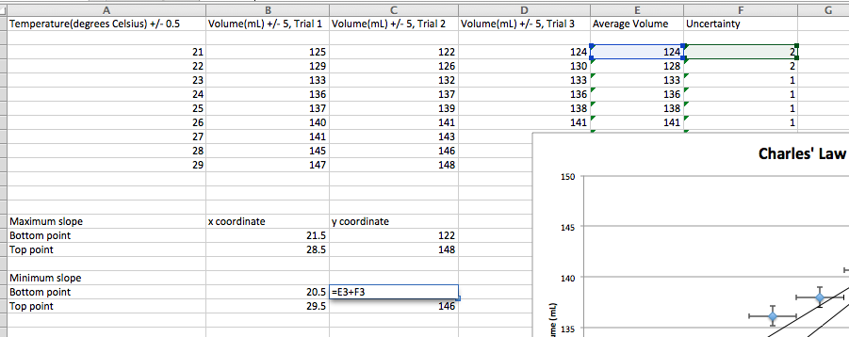
Creating the minimum slope
TOP LEFT CORNER OF THE FIRST RECTANGLE: the x coordinate is smaller than the data point by an amount equal to the horizontal uncertainty.
The y coordinate is larger than the data point by an amount equal to the vertical uncertainty.
Use Excel to calculate the coordinates for you.

Slide 19
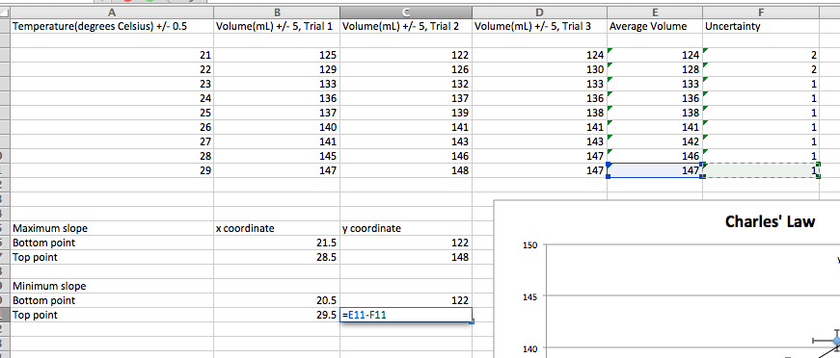
Creating the minimum slope
BOTTOM RIGHT CORNER OF THE LAST RECTANGLE: the x coordinate is larger than the data point by an amount equal to the horizontal uncertainty.
The y coordinate is smaller than the data point by an amount equal to the vertical uncertainty.
Use Excel to calculate the coordinates for you.

Slide 20
Creating the minimum slope
Add another data series as you did for maximum slope. Entitle this one “Minimum slope”.
Add a trendline for these points, and display the equation on the graph.
You will end up with three lines on your graph.

Slide 21
Interpretation
From these results we could conclude that:
- The slope is somewhere BETWEEN the minimum and maximum slope (Between 2.36 and 3.68 in this case.)
The y-intercept is somewhere BETWEEN 43.1 and 66.2
(In this case it would have been better to graph temperature in Kelvin…that way we could examine the y-intercept for accuracy – the temperature should be 0 K when volume is 0, so y-intercept should be 0).

